Slide 1
Group 7 Final Presentation
Aditya Wirya Darma, Ingrid Wendin, 林玲琪, Isabella Obermeier

Slide 2
Agenda
Quick Review
Sketches
Interface
Prototype

Slide 3
Our Original Idea: Job Pairing Service
Create a platform for users to be automatically paired with jobs based on their education, past experience, and interests.
After users opt into our service and create a profile, our platform performs data collection through APIs to match the user’s interests with available jobs from various companies.

Slide 4
Review: Why the service is needed
Don’t know what opportunities are available
Employees
Workers are not happy in their current jobs and do not have the energy or time to find a new job.
Companies
Constantly looking for new employees but rely on applications and do not find the most qualified person for the job.
Don’t know where to find the company’s info
Don’t have the motivation to find a better job
Limited to jobs within his/her country

Slide 5
Review: Our Solution
Accessibility
Easily use the available data from online databases such as LinkedIn, Academia, Facebook.
Application
After a company posts a job, our service will match the job with an applicant based on keywords from their interests.
Adaptability
Will be able to use translation tools so that companies can reach out to international workers.
Users simply keep their profiles up to date, they don’t need to upload information many times.
Less hassle since users will get an email notification of the available jobs.
Automatic translation will remove the intimidation of applying to a foreign company.

Slide 6





Review: System IPO
Users can access the job data via
-email
-website (mainly settings)
Input
Process
Output
Users’ Data
-Qualifications
-Previous work
-Basic info
Job data
-Positions
-Location
-Working hours
-Salary
Web crawler
Matcher
Interpreter/Analyzer
Compiled data of user profile
List of job matches
Links to the job application
Email notification to user

Slide 7
Sketches

Slide 8
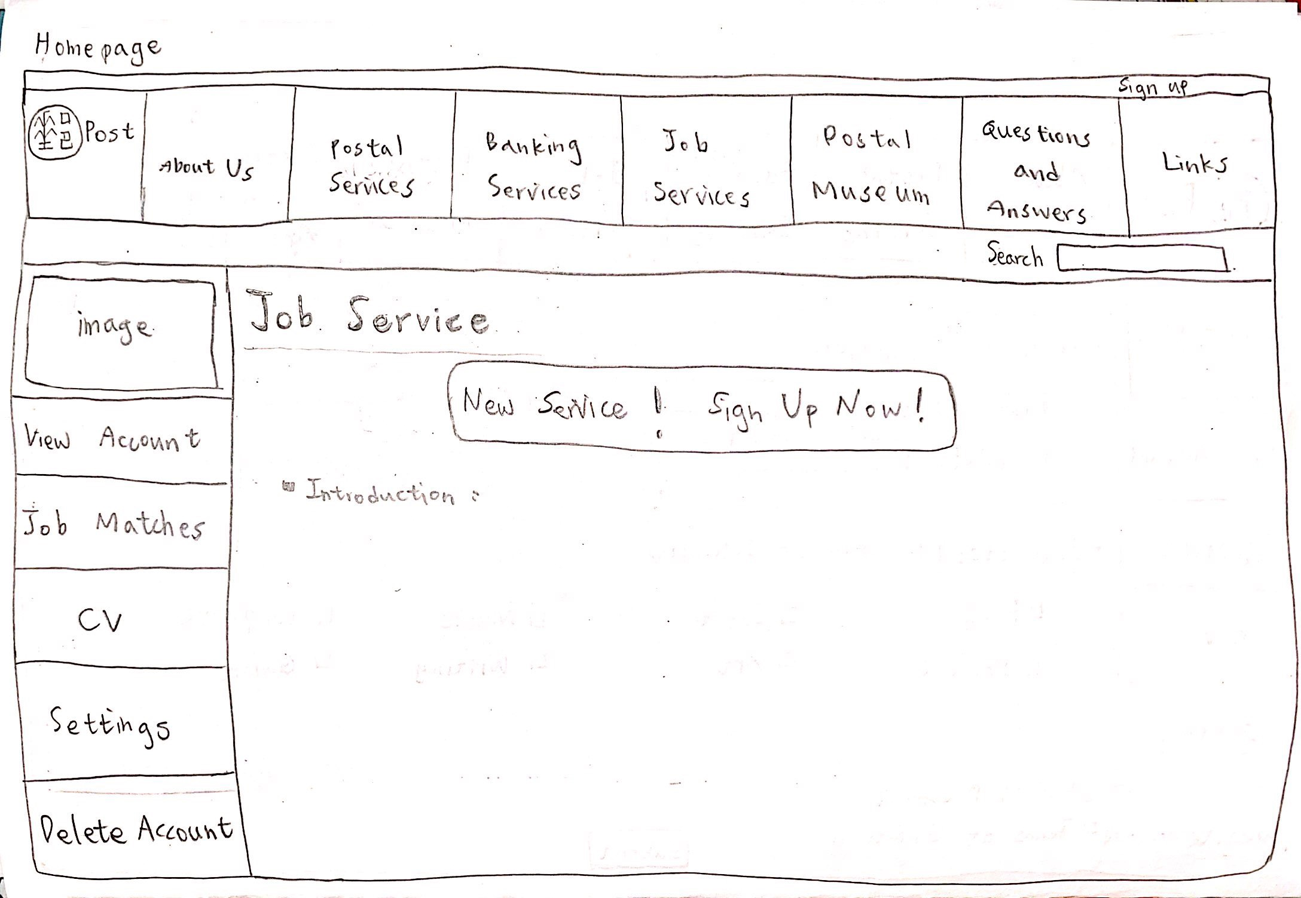
Homepage
-Sign up button for new users to sign up
-Introductions of job service
Notes:
this is our homepage. on the top is the menu bar shows the services that chuanghua post provides, and our job services is right here. the left column shows what you can do in the job services. because this is the first page user will see, we designed a big sign up button to catch users attention. and below is some introductions of the job service. and after clicking on the button you will see next page

Slide 9
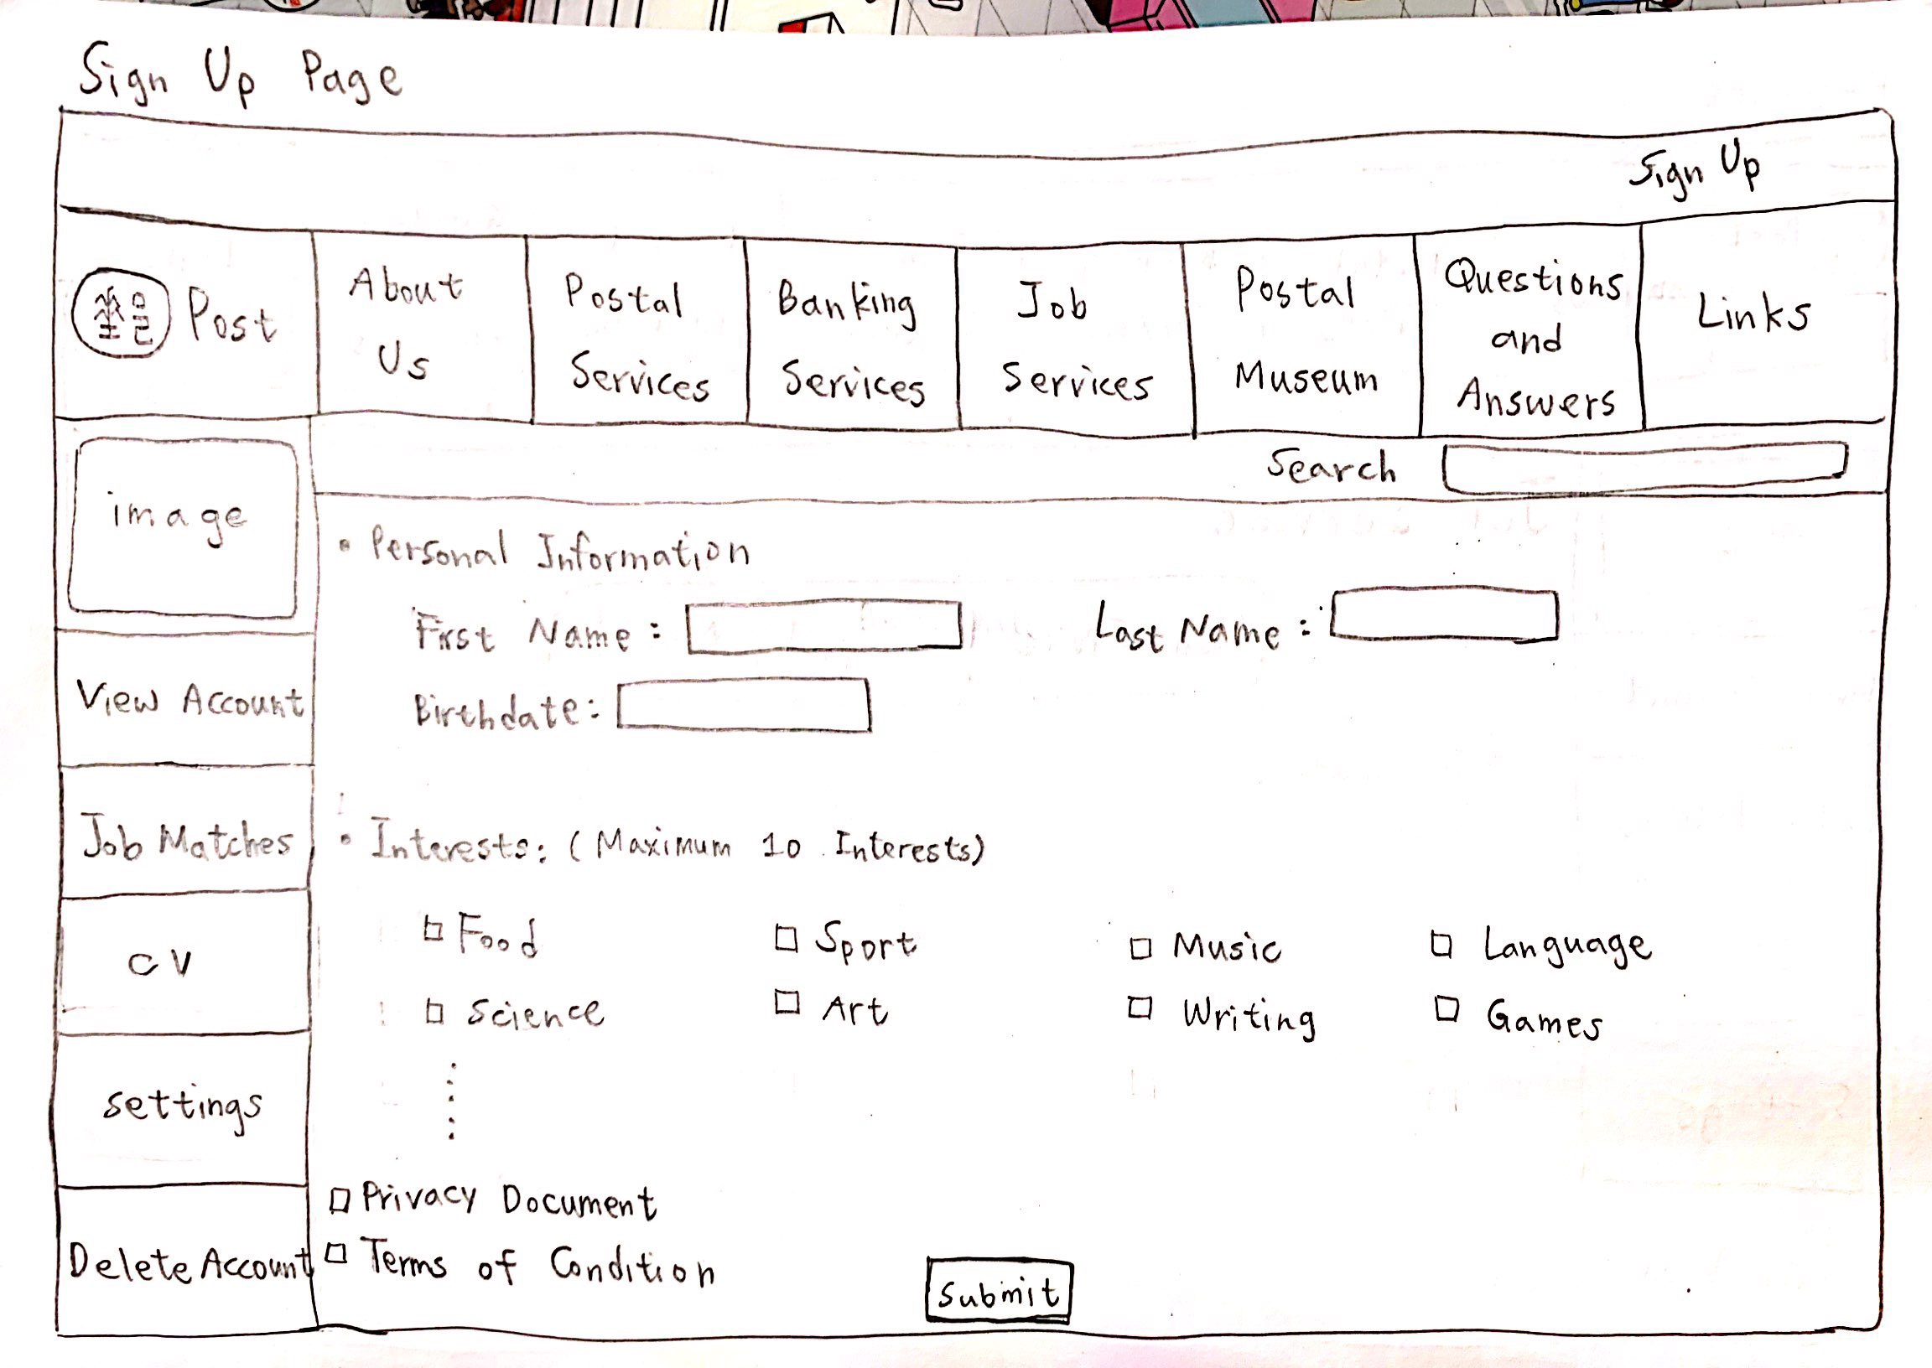
Sign up
-Key in personal info
-Select interests with max 10
-Cannot submit before confirming privacy document and terms of condition
Notes:
this is the sign up page. user can key in their personal information. and for the interest part user can select one to ten interests.

Slide 10
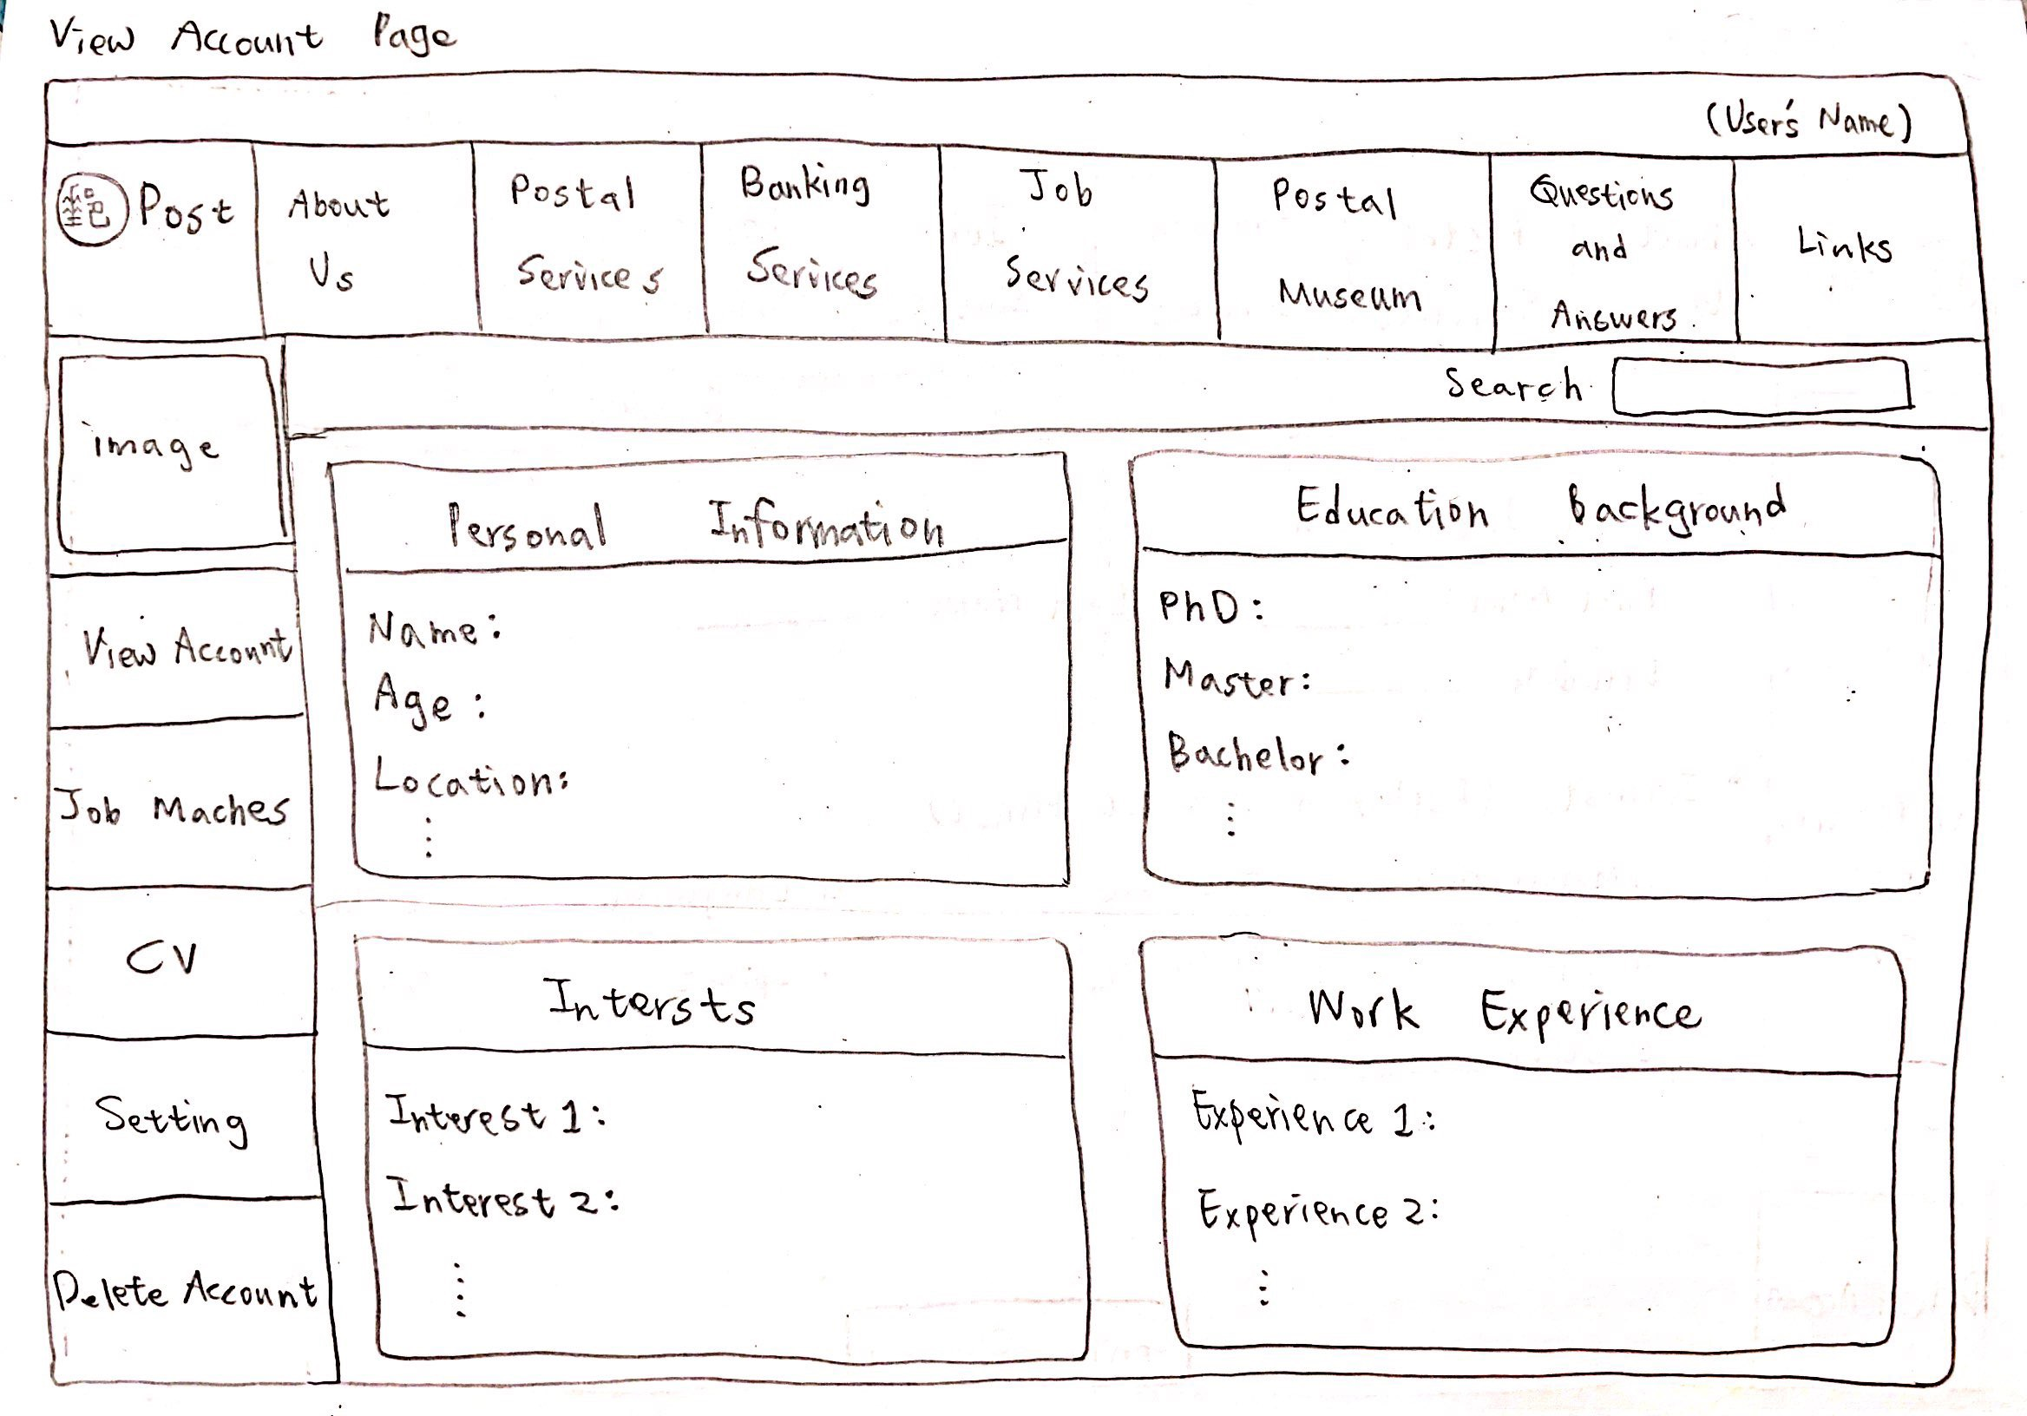
View account
-For user to view his/her own profile
-Click on the categories for detailed information
Notes:
in the view account page, you can see your profile, which includes personal info, education background, interests, work experience and so on

Slide 11
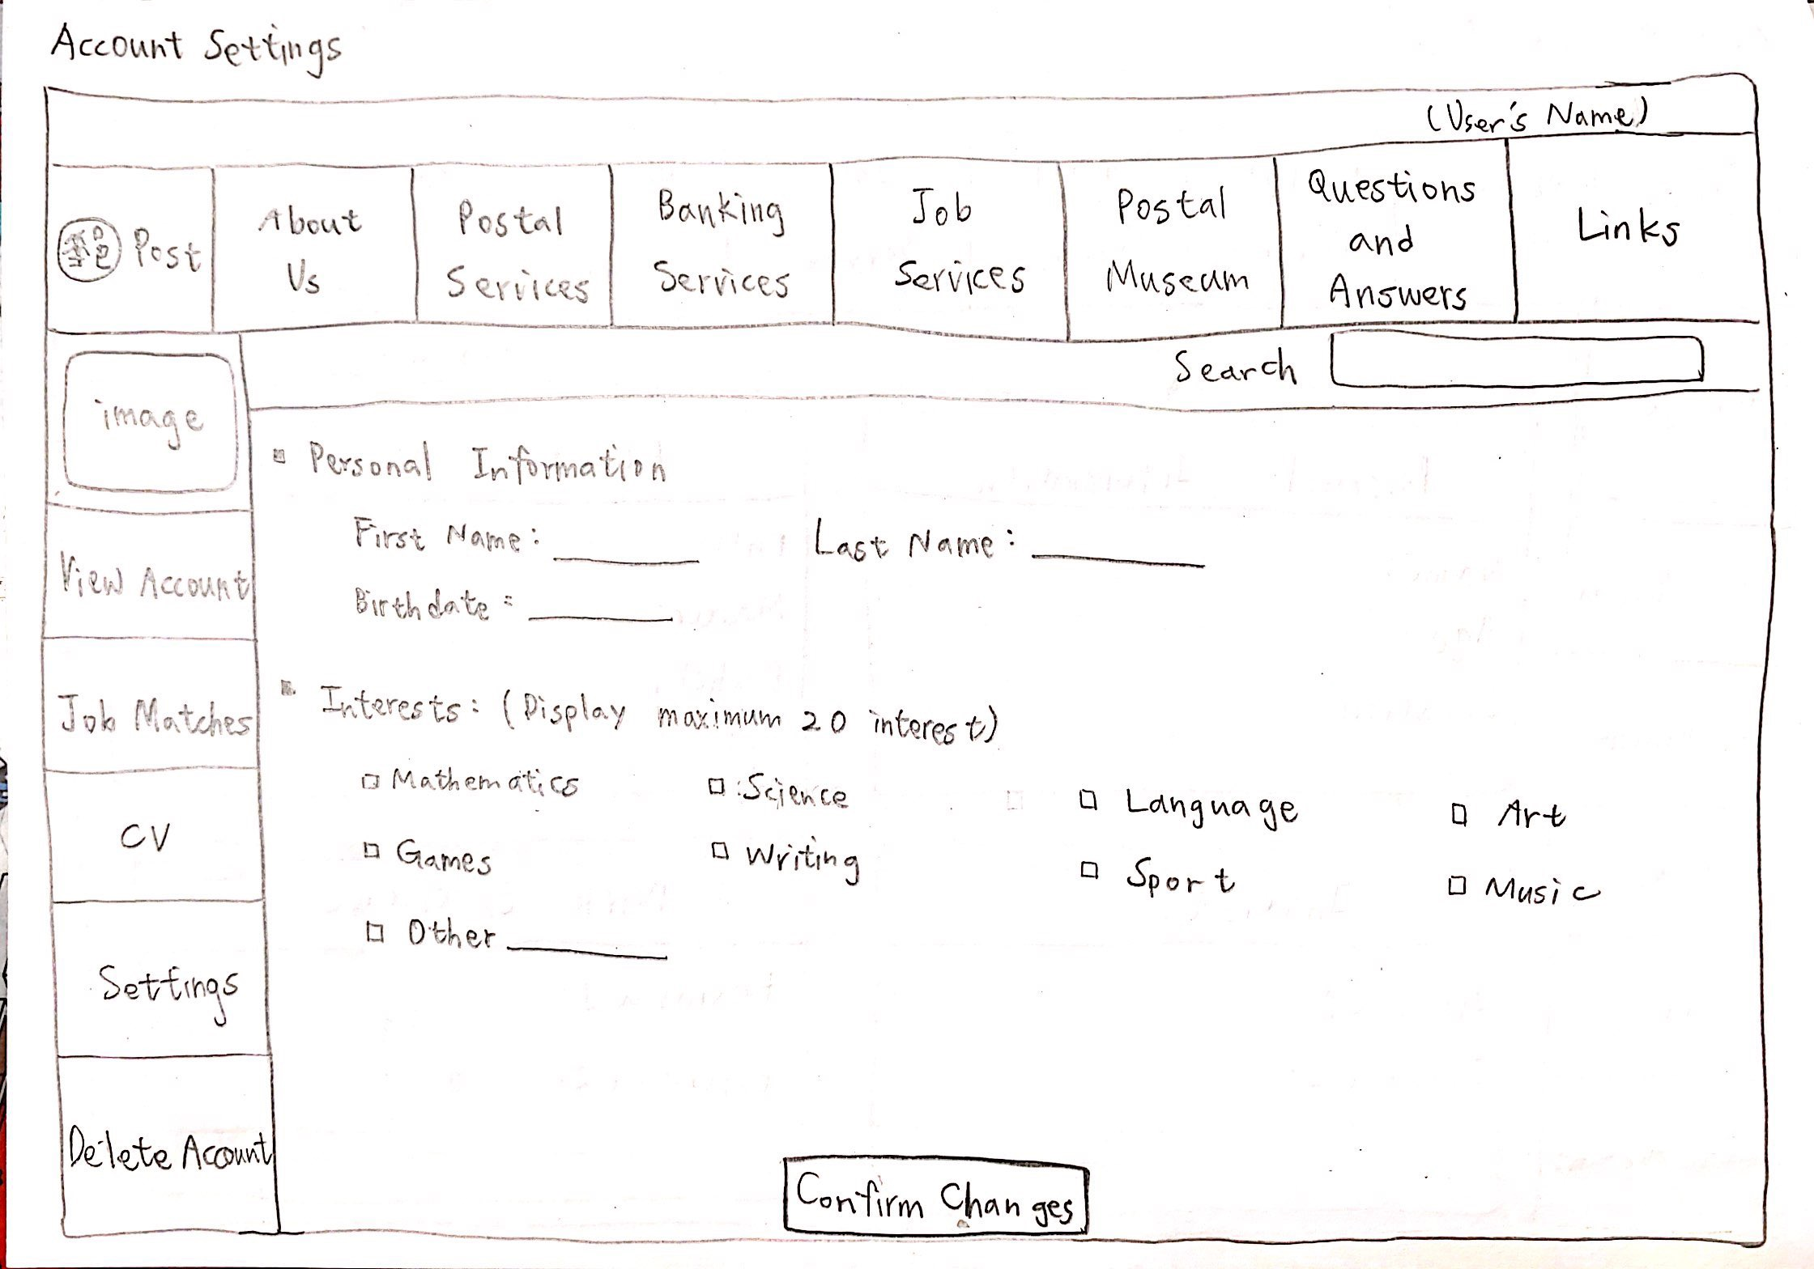
Account settings
-For user to edit his/her own profile
-Show top 20 interests from the web crawling
Notes:
if user want to edit their profile, they go this account settings page to make some change, this page would basically look like the sign up page i mentioned before.

Slide 12
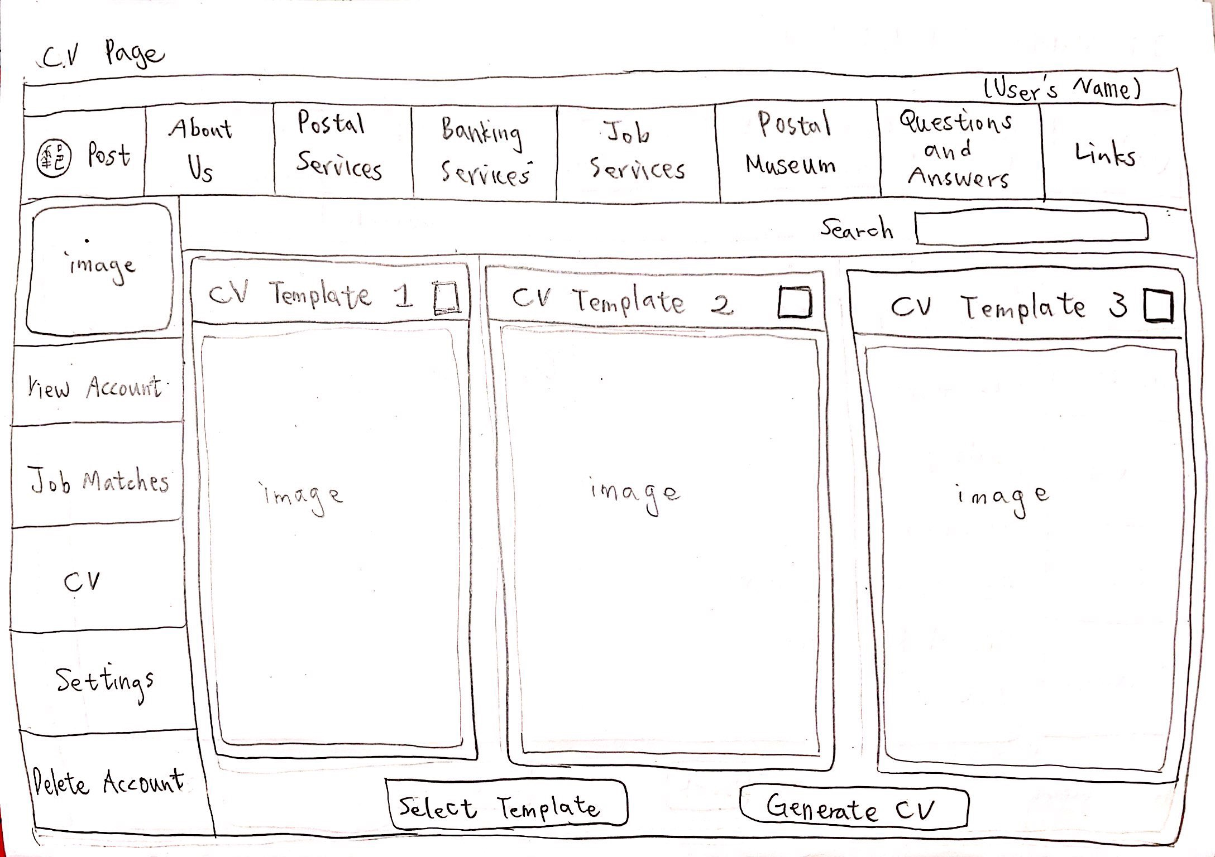
CV
-Several templates for user to choose from
-Select one CV template and the system will generate CV
Notes:
for the cv page, it shows some cv templates for user to choose from. users can just simply select a template that they want and the cv will be generated by the system. so they don’t need to key in everything by themselves.

Slide 13
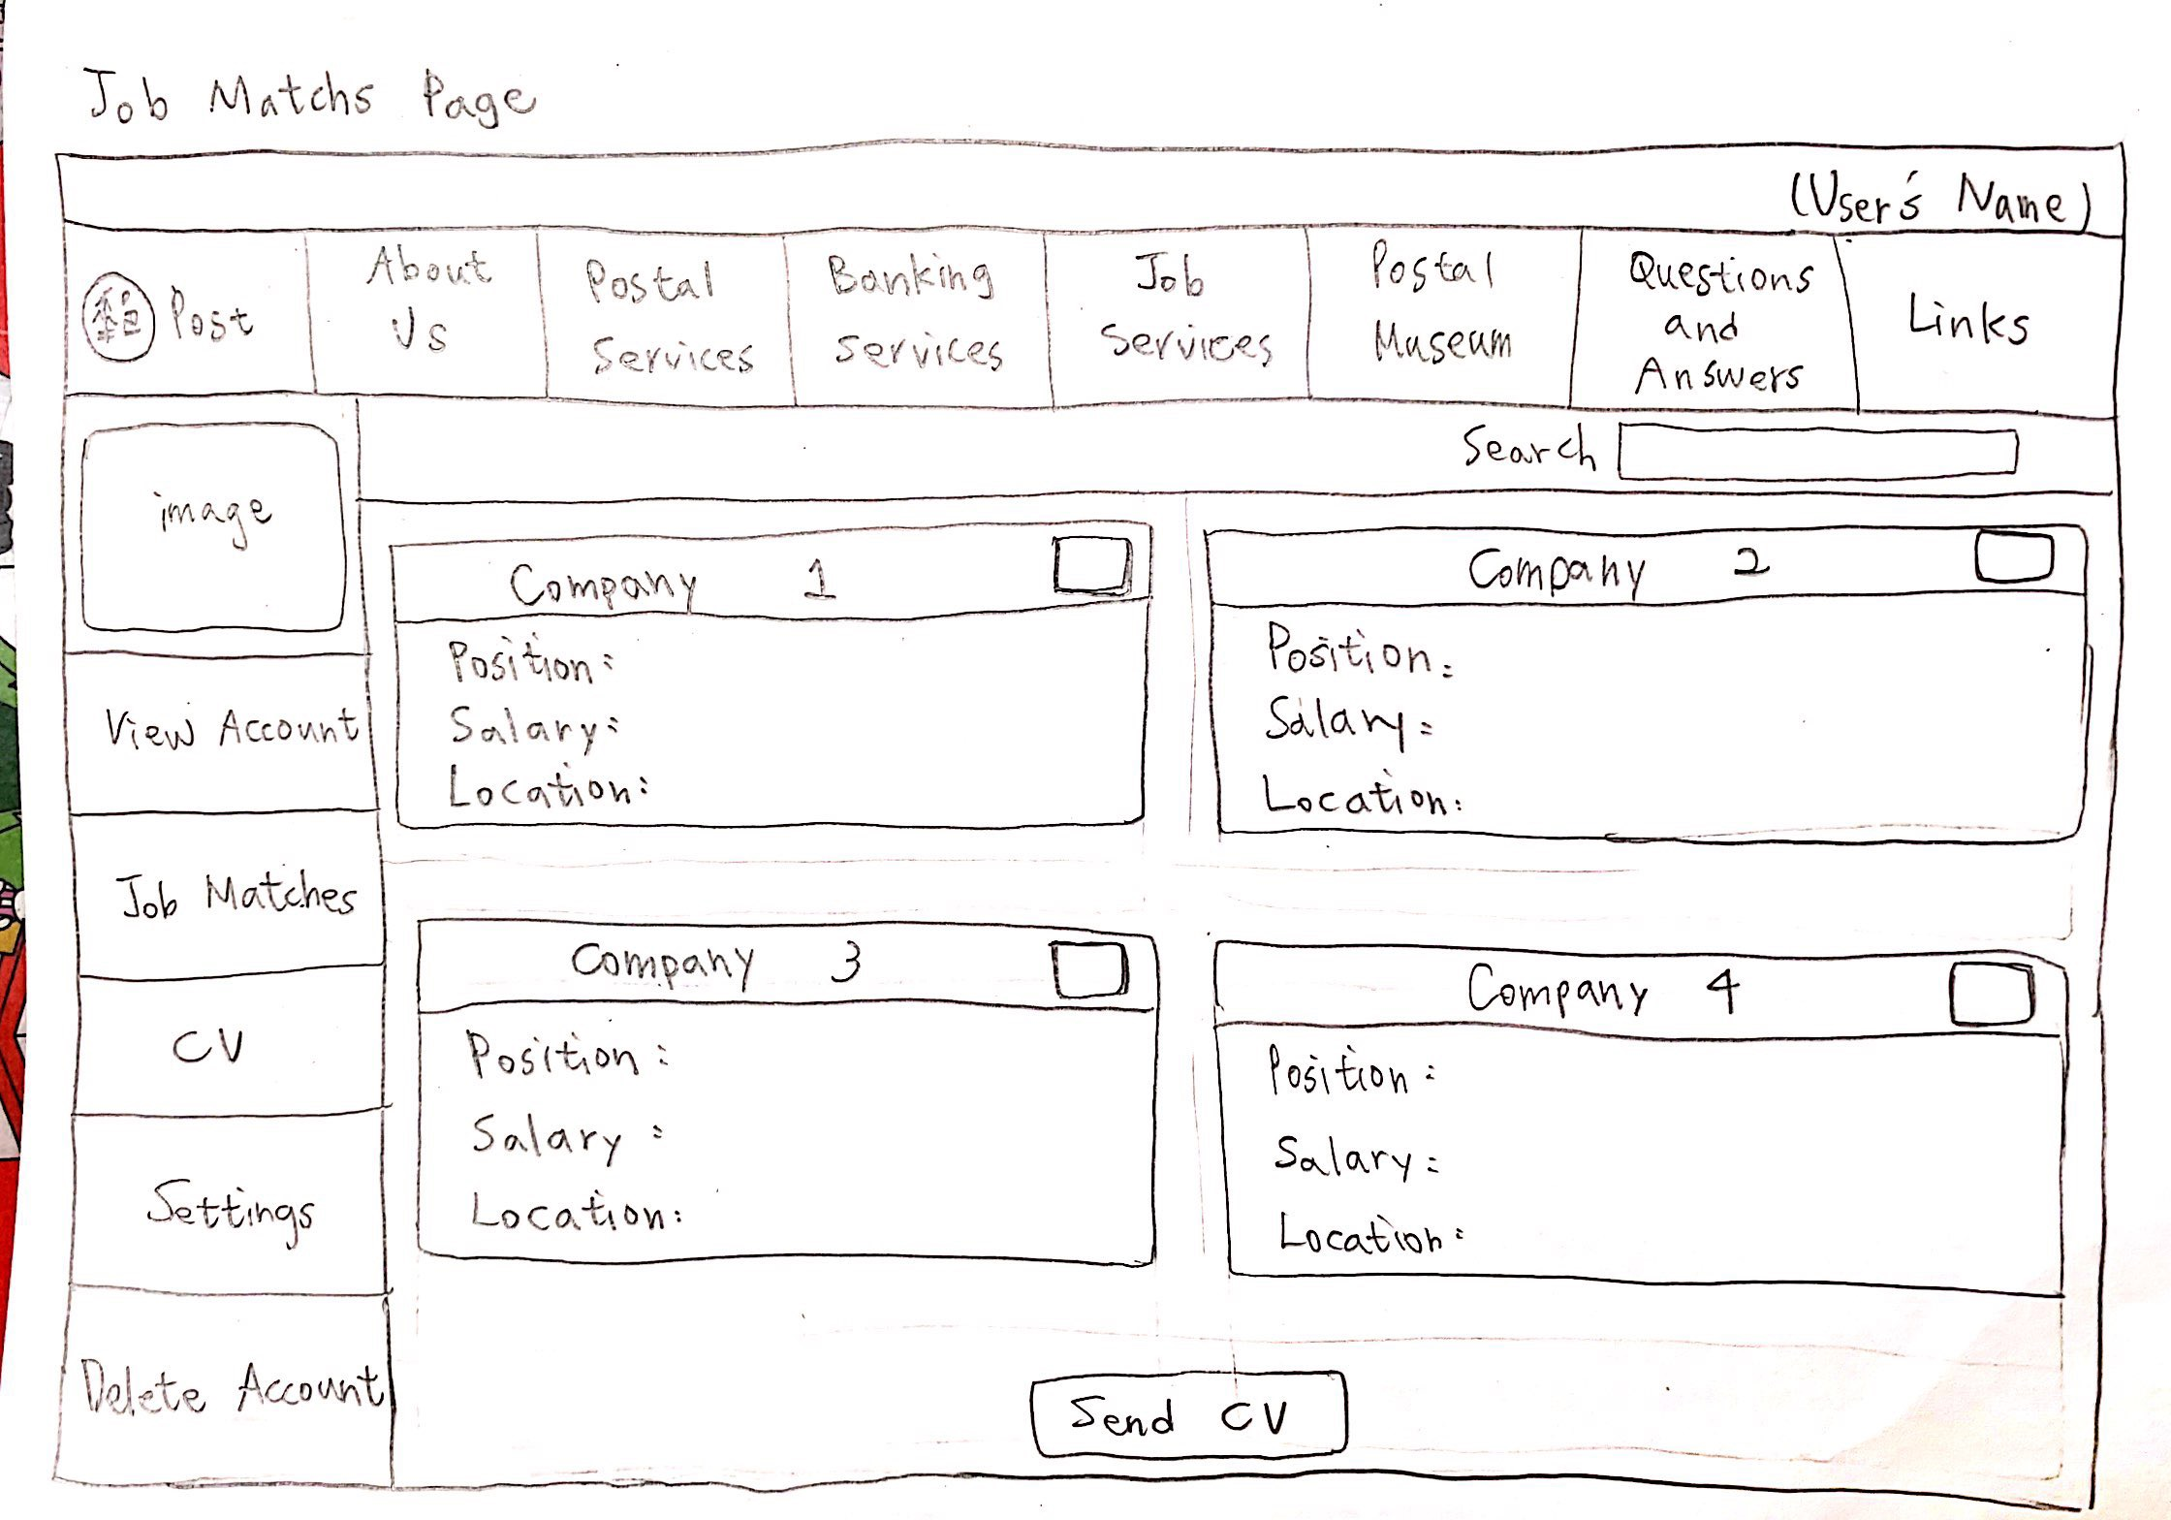
Job matches
-Shown job matches
-Only show major job info
-Scroll up and down to see more matches
-Select jobs you want and send cv to companies
Notes:
in the job matches page, users can see the matches that system found. we wanted this page to be easy-to-read, so only some major information would be shown in this page, such as position, salary, and location. if you want to see more detailed information, just click on the job match.

Slide 14
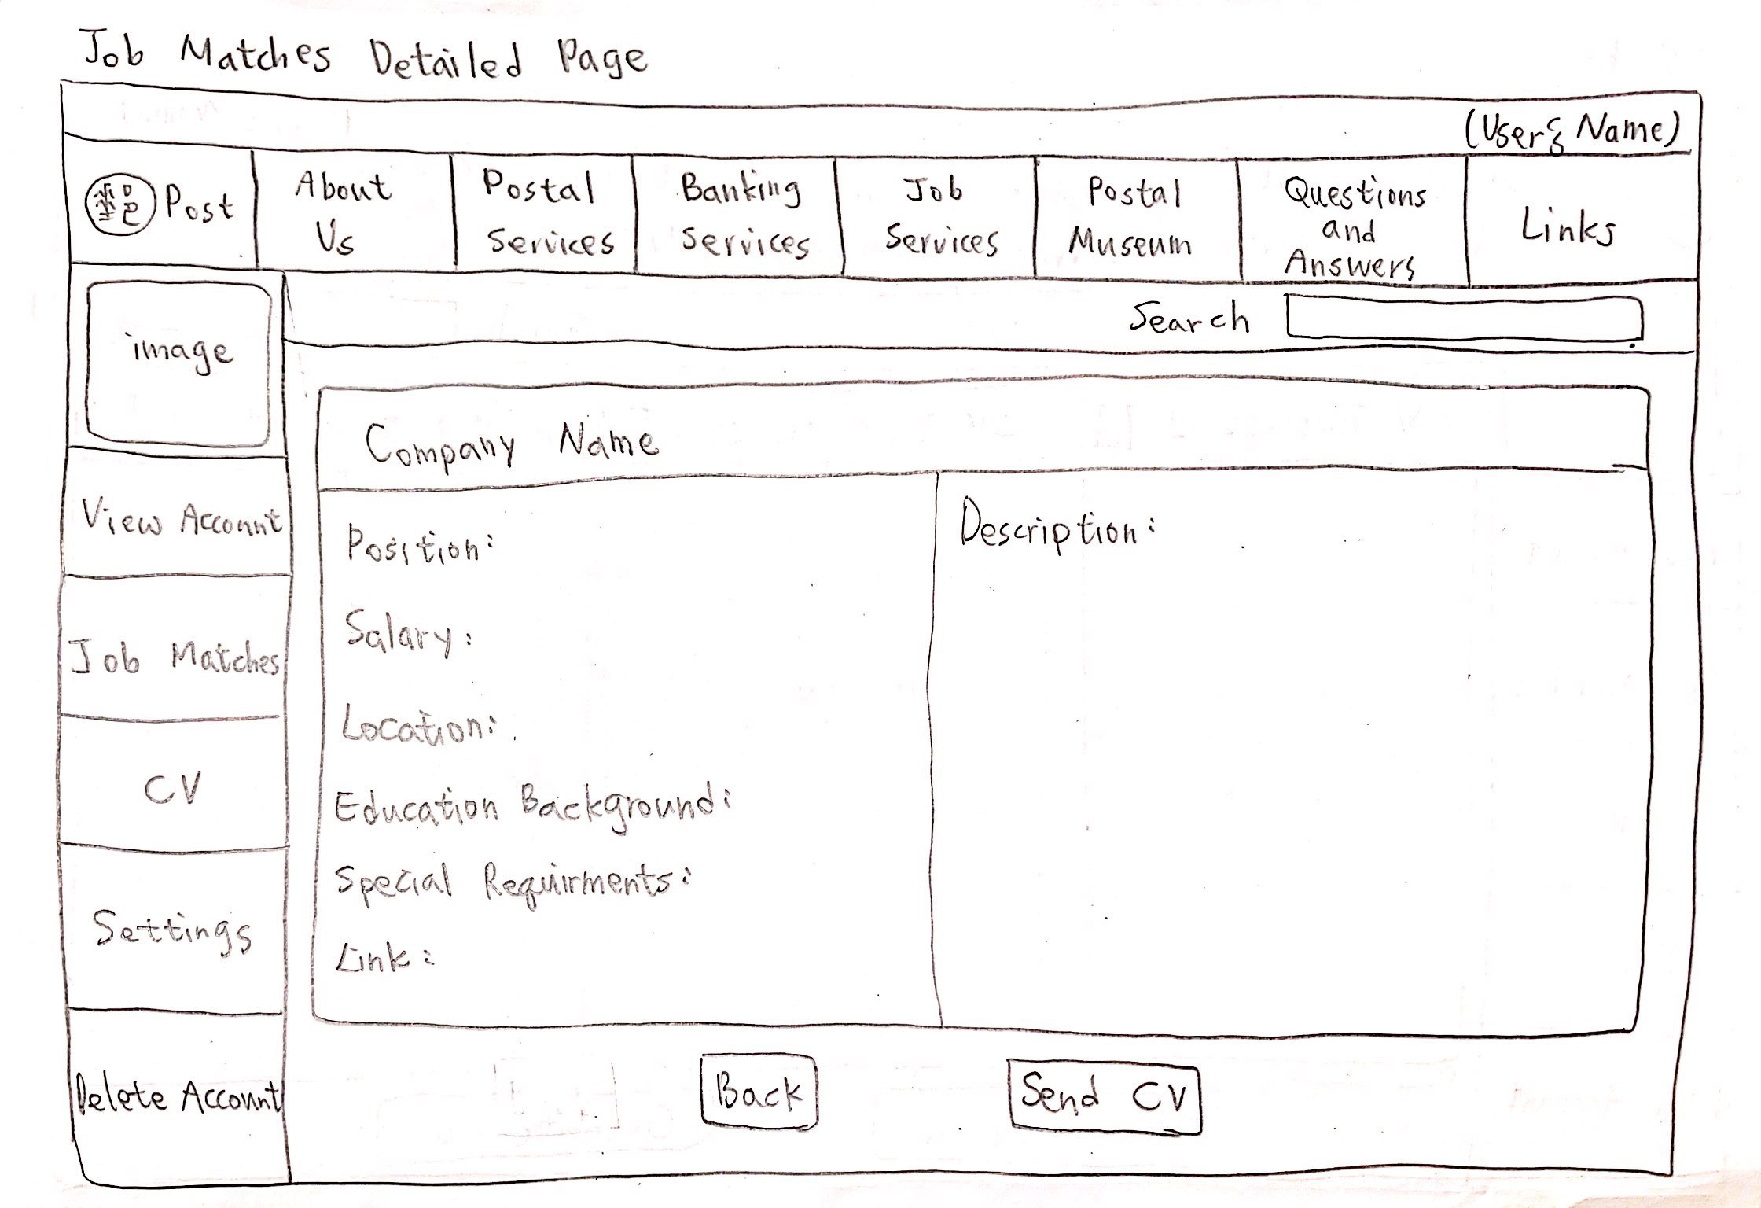
Job matches (detailed)
-Detailed job info
-User can send cv to the company in this page also
Notes:
this page is the detailed information, on the left would be some informations and requirements. on the right would be the description of the job.

Slide 15
Interface

Slide 16
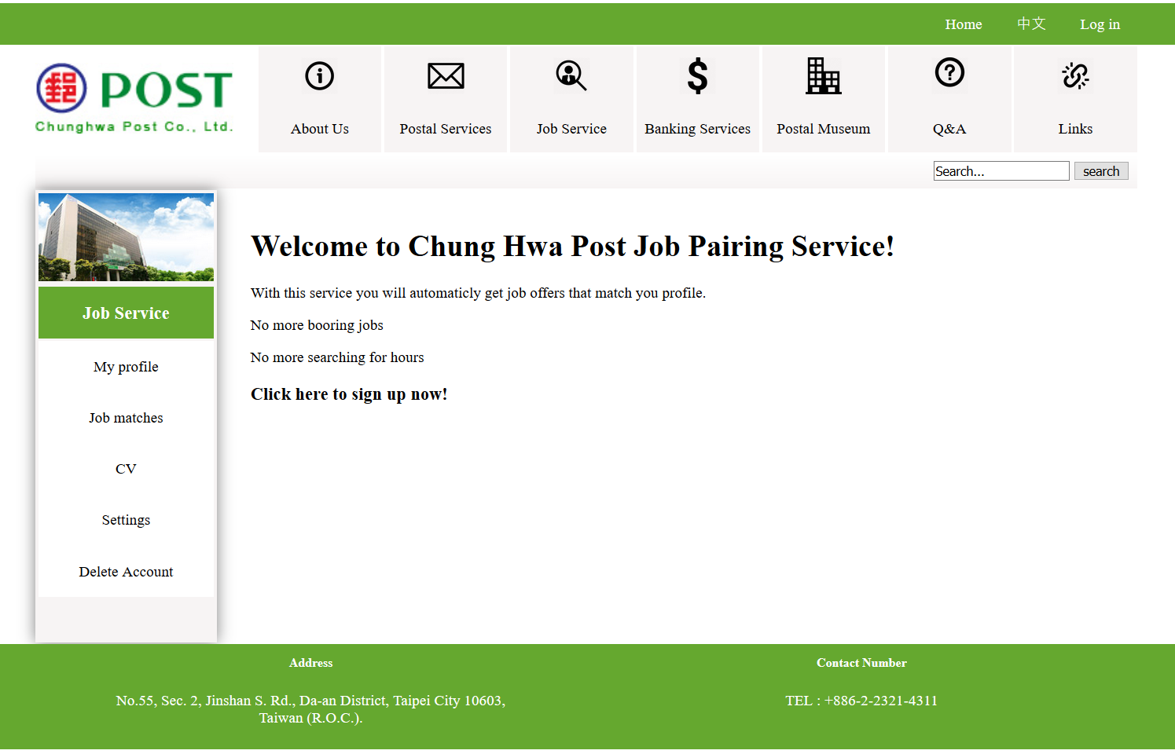
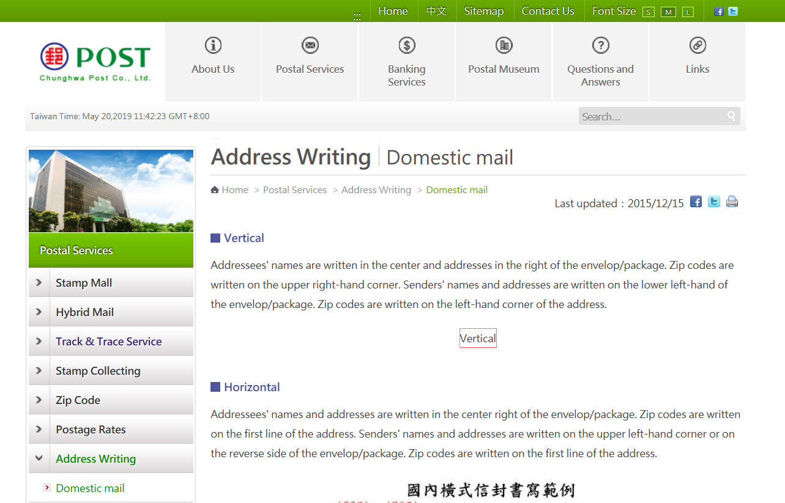
Front end: Design
-Cleaner version of original
-Same colours, barely no gradients used
-Top and side menu lights up when hovering over
-Log in in corner
-Settings: email frequency
-Delete Account: Easy to find
Our design
Original design
Notes:
https://amazingteam.site/homepage.php

Slide 17
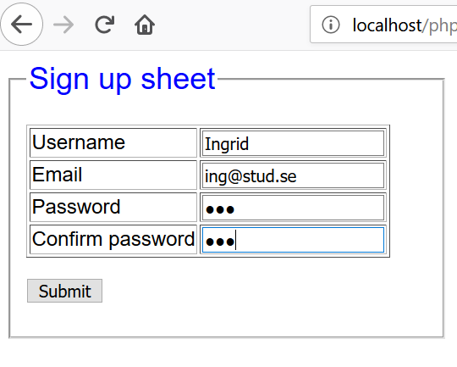
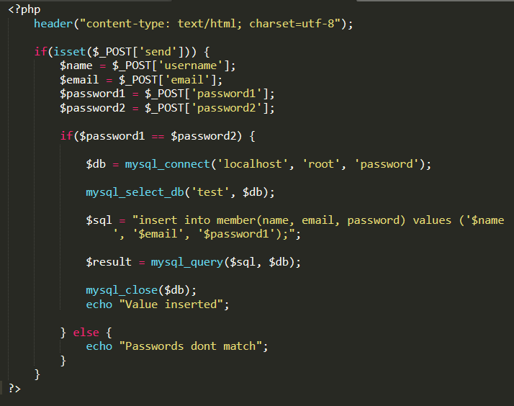
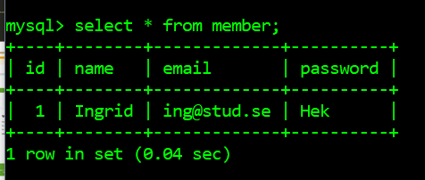
Back end: MySQL, php
Notes:
https://amazingteam.site/homepage.php

Slide 18
Homepage
-Top and side menu lights up when hovering over
-First page people will see
Log in in corner
-Sign up message
-Information about the service

Slide 19
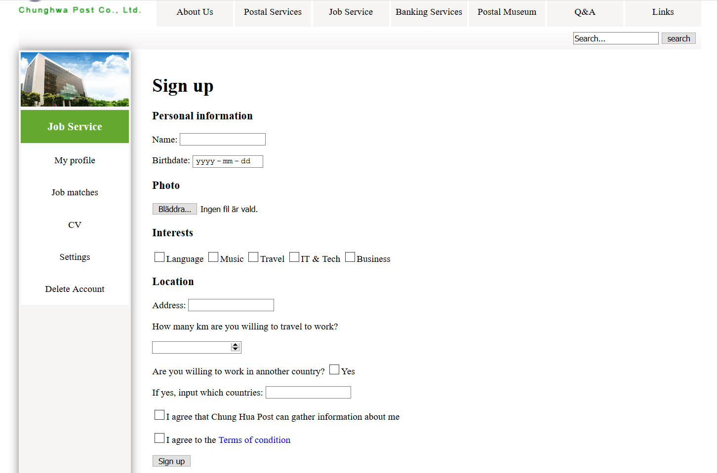
Sign up
-Have to go through in order to use the service
-Side menu expands with site

Slide 20
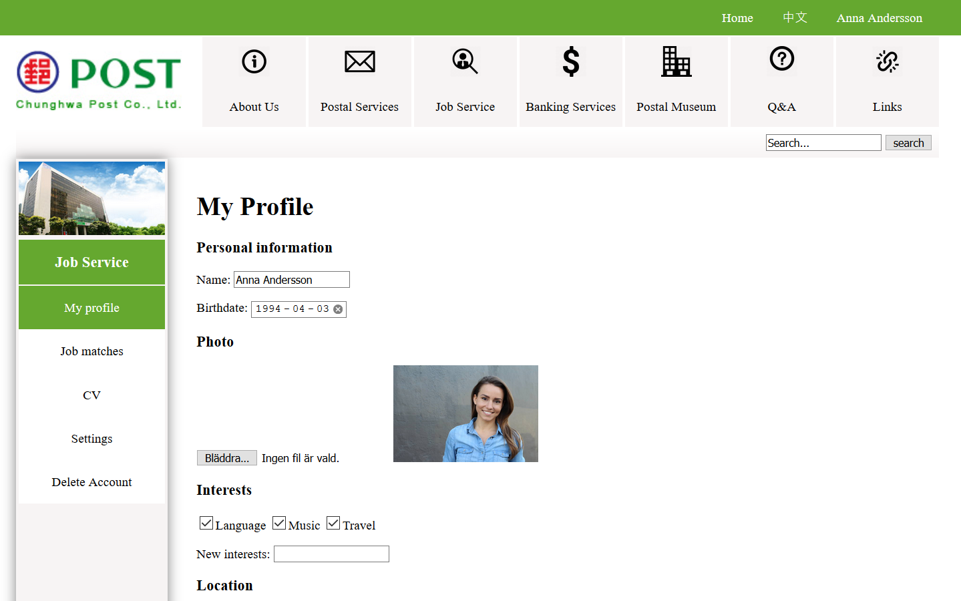
My profile
-When logged in the Log in message will display the name
-Displays a condensed version of the profile in our database:
->Information from sign up
->Information from crawling
User can edit the content

Slide 21
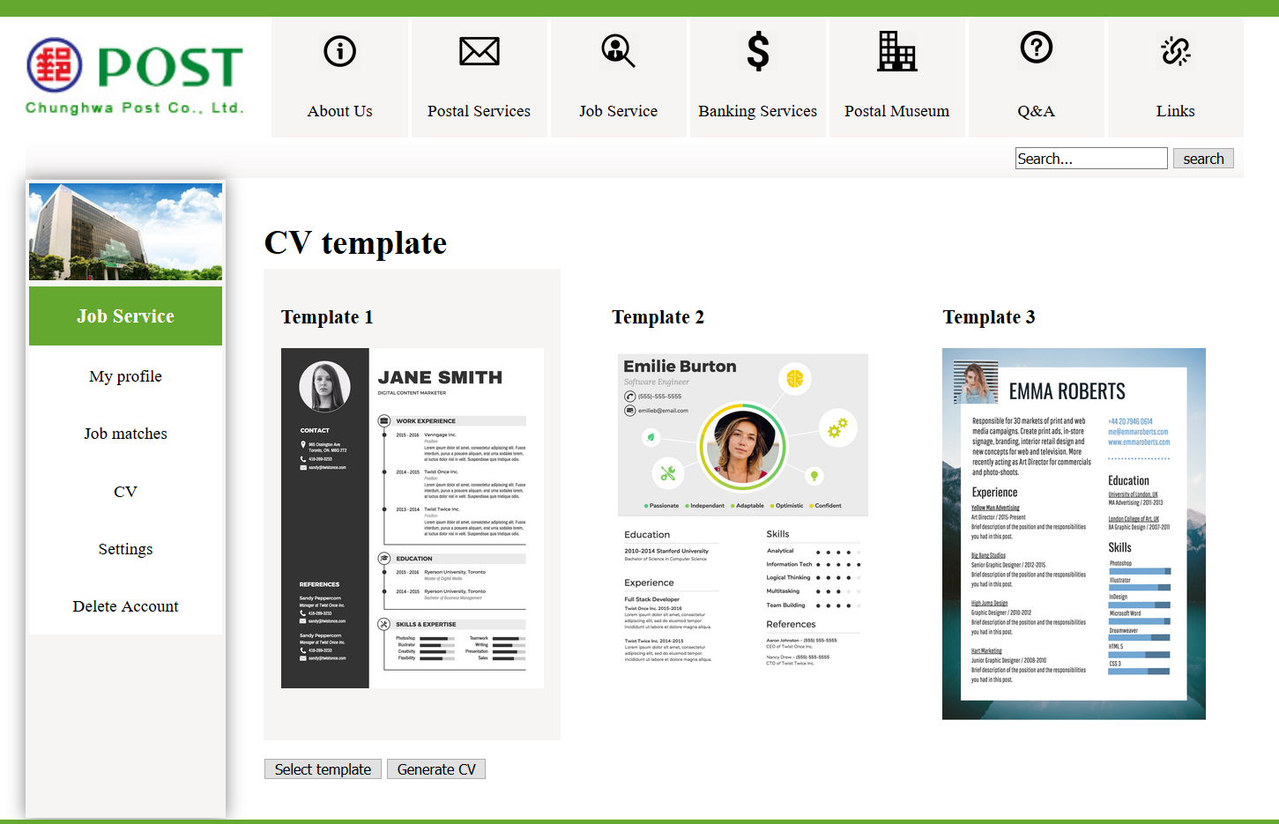
CV
-Has a few CV templates to choose from
-Can preview design
-Light up gray when hovering mouse

Slide 22
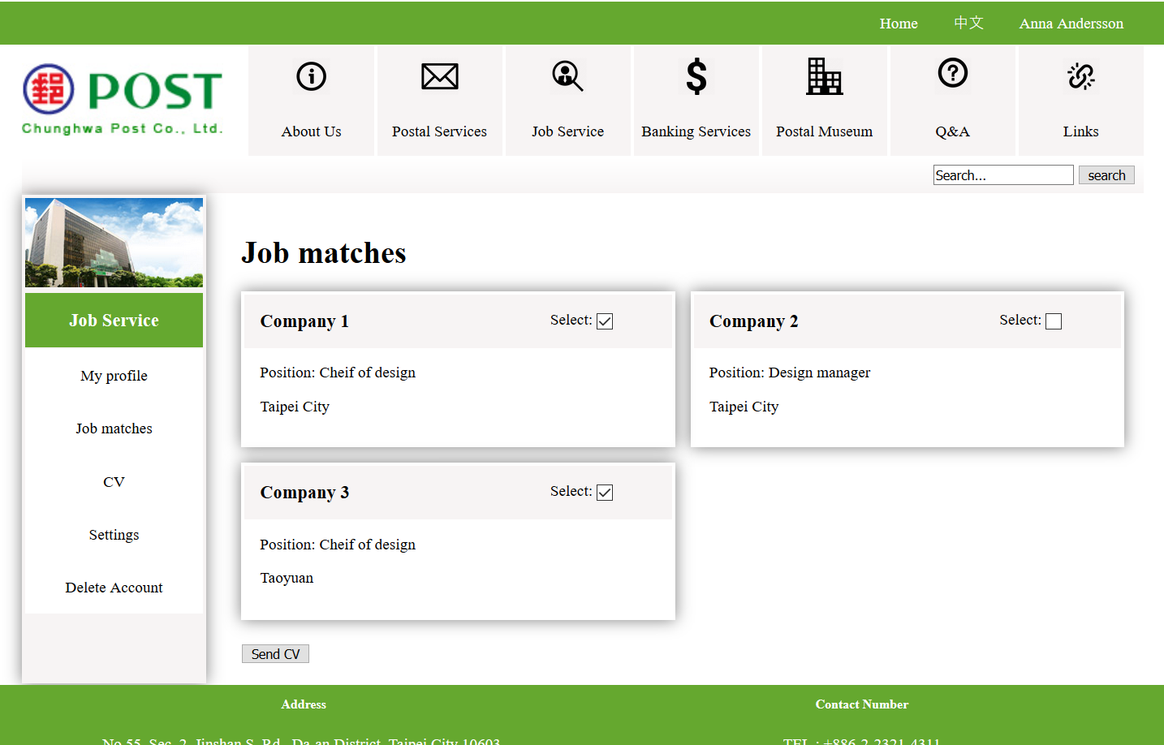
Job matches
-Select the matches you want to send CV to

Slide 23
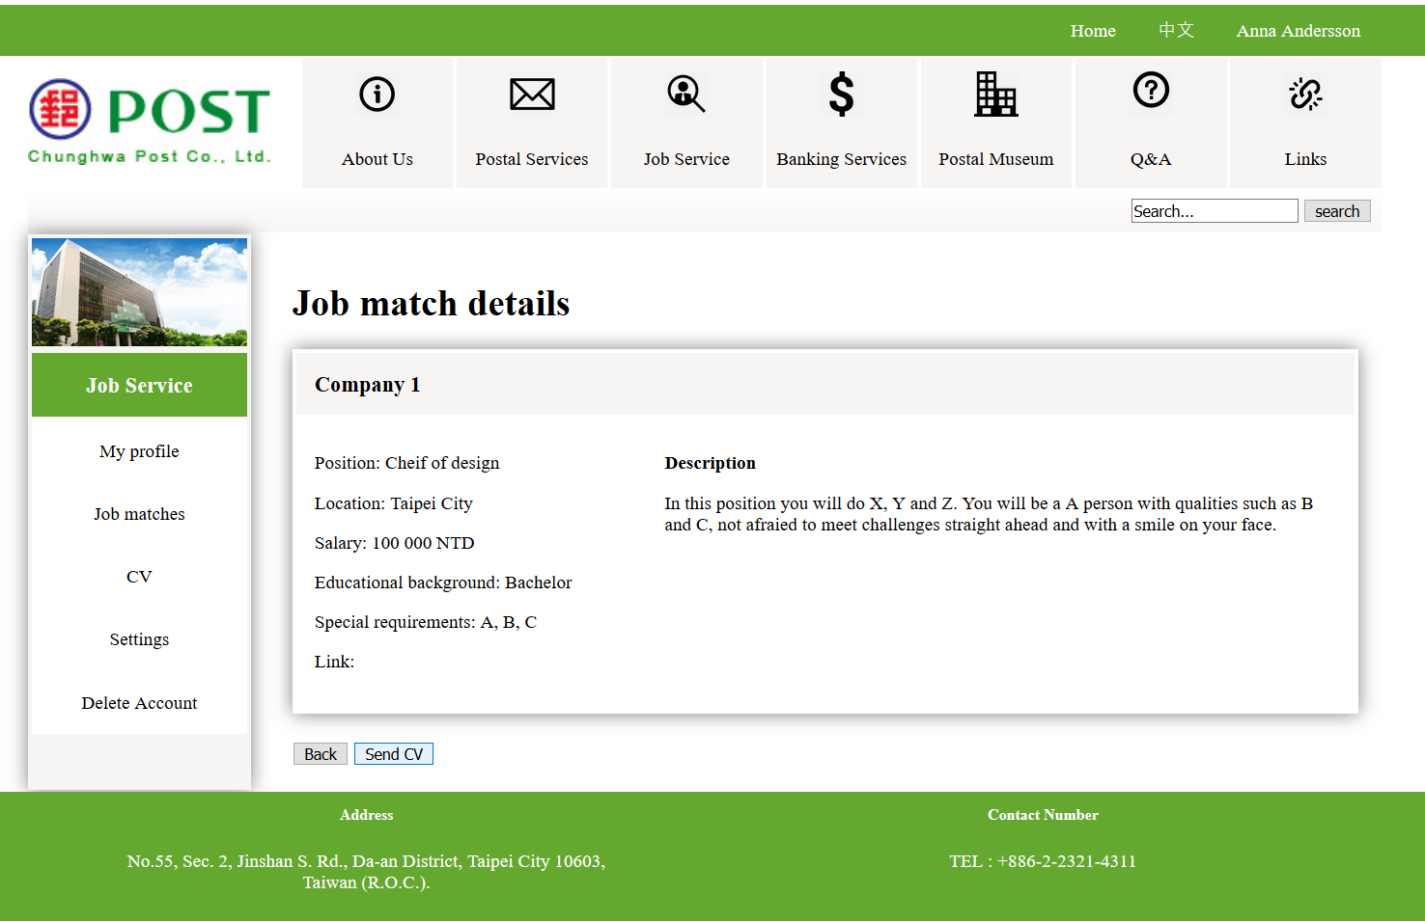
JM: detailed
-If details is wanted
-Hovering over buttons makes them blue

Slide 24
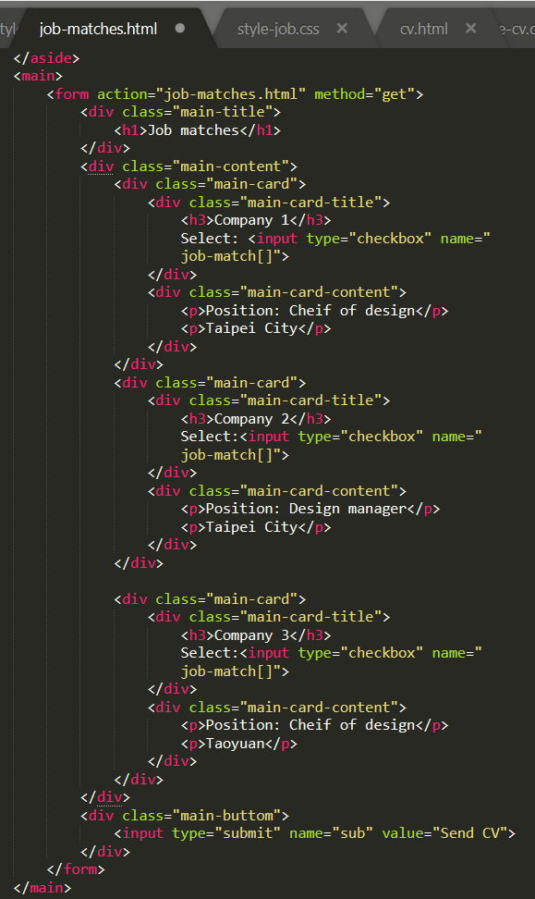
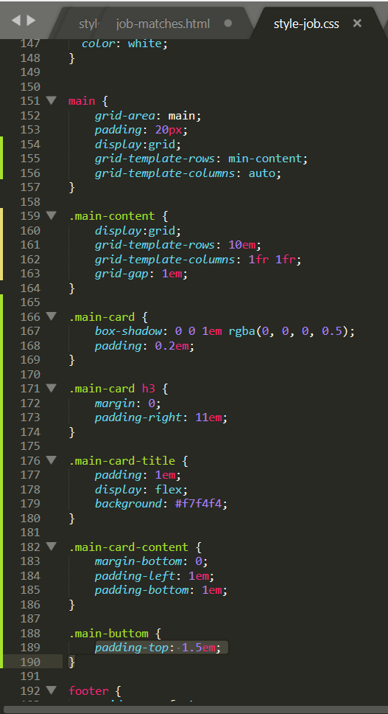
Code: grid
-Html outline
-Css style documents
Html grid
Homepage, Sign up, My profile had same outline
-> same Css document

Slide 25
Prototype

Slide 26
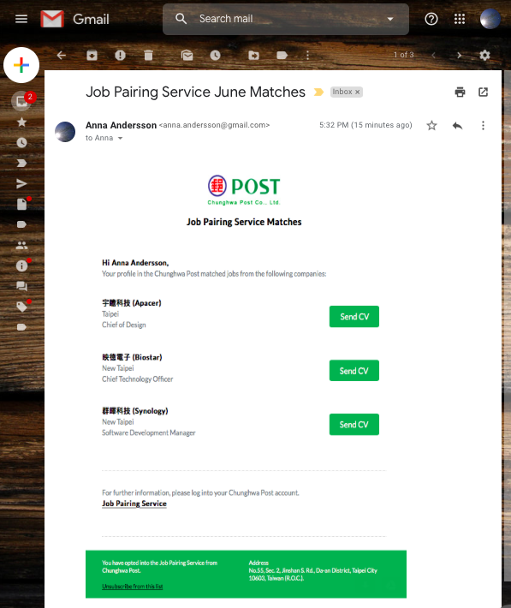
E-mail

Slide 27




Modules | Job
Web Crawler | Gather data online(user and job data)
Matcher | Pair user with matching jobs
Interpreter / Analyzer | Fill missing gap if needed
Sources
Job Offer Website

Slide 28
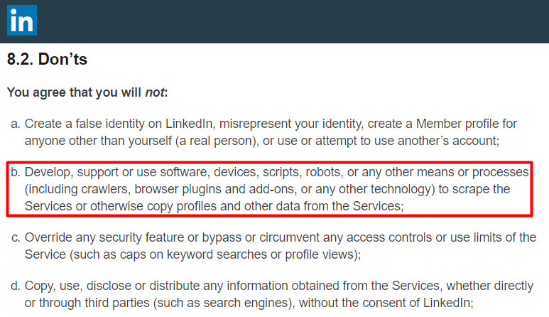
Web Crawling
LinkedIn API
Need:
Company
Website
Permission from user
Solution?
Make your own company

Slide 29
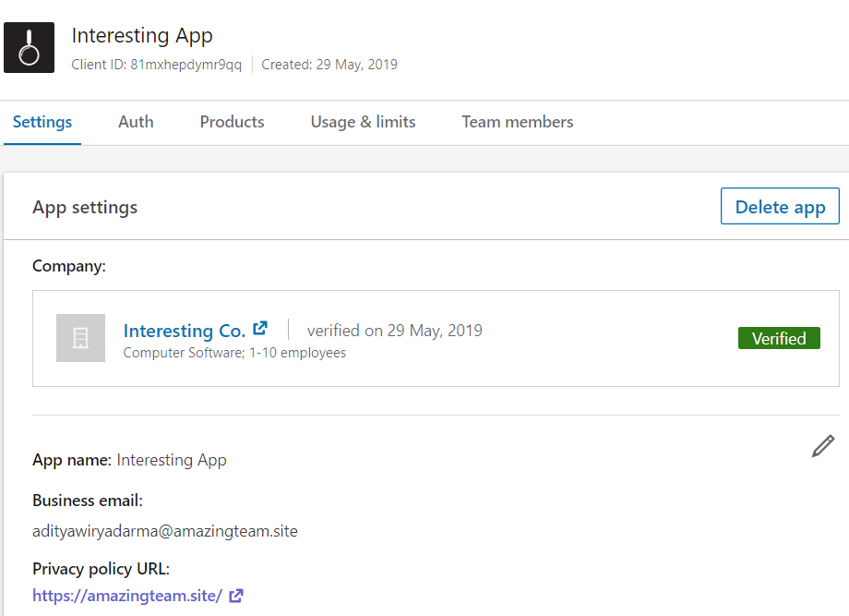

Slide 30
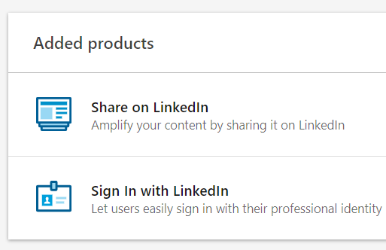
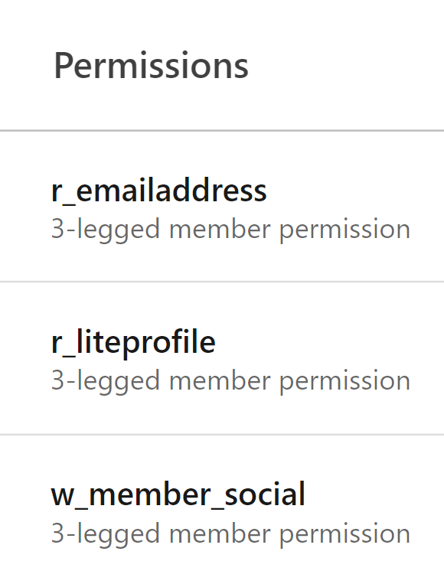

Slide 31
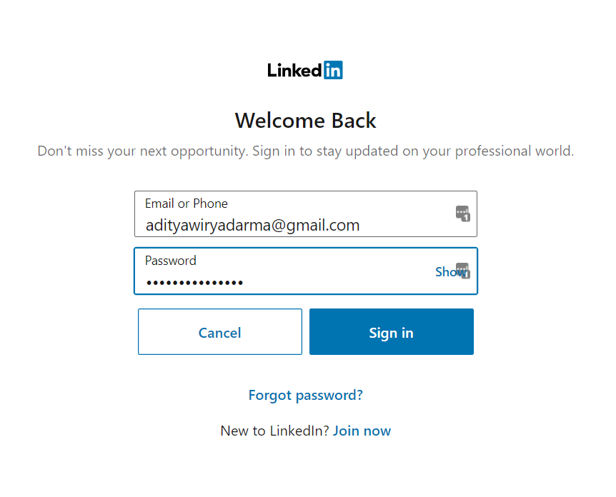
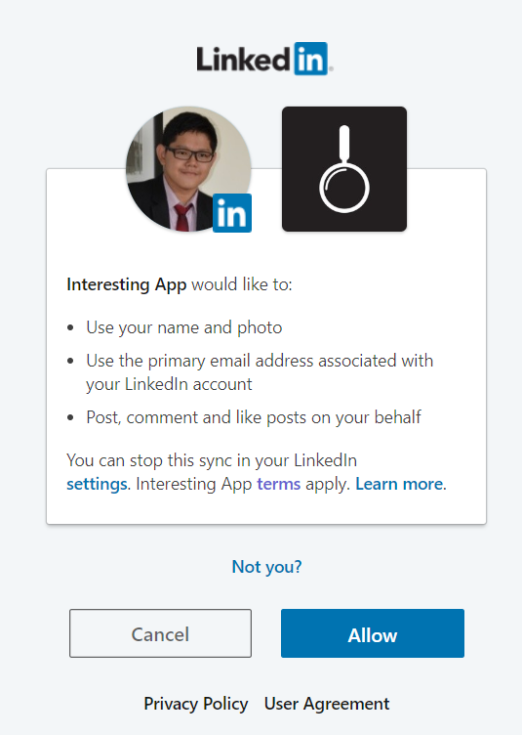
https://amazingteam.site/access.php

Slide 32
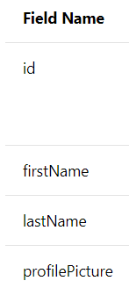
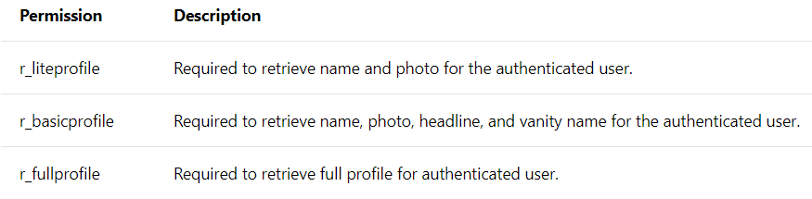
What we currently have
Need certain permission directly from LinkedIn

Slide 33
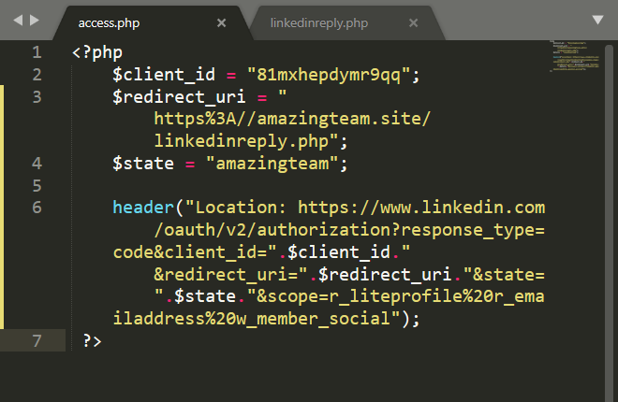
Getting Authorization code

Slide 34
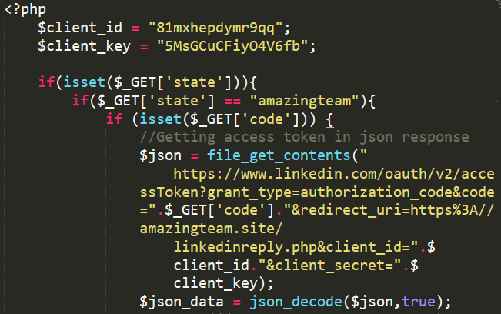
2. Exchange the Auth code with access token

Slide 35
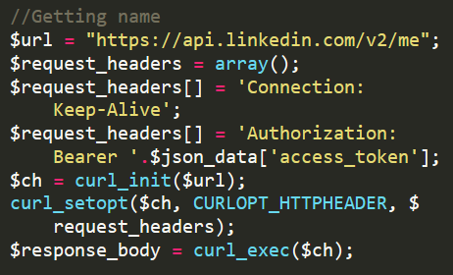
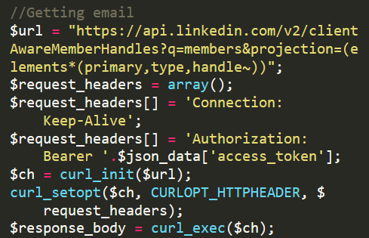
3. Get your data
r_liteprofile
r_emailaddress

Slide 36
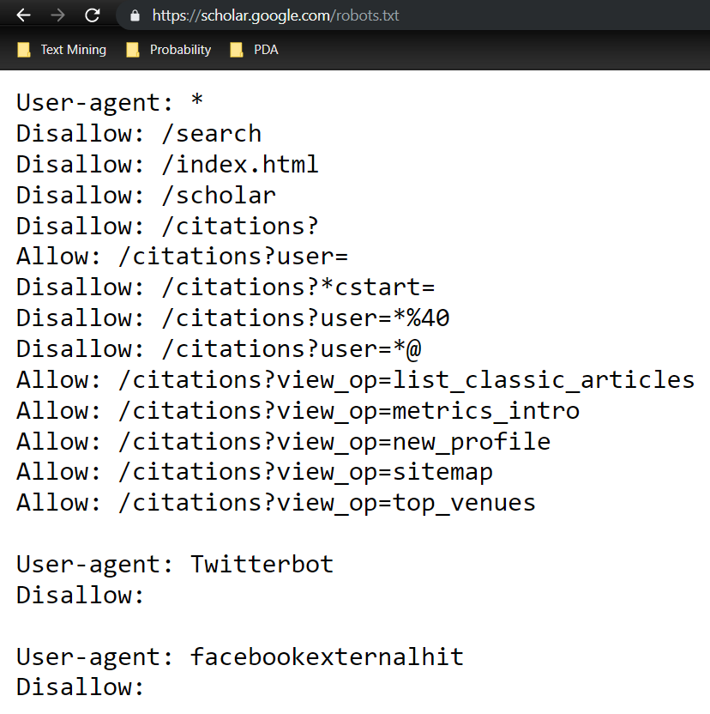
https://scholar.google.com/robots.txt
No API to date, so web scraping is our only choice
Web Scraping it is!

Slide 37



Python
Library
Very straightforward
Uses Beautiful Soup
We initially used this one
New Bug since last month
Framework
Creates bots/spiders that will ‘crawl’ your designated website
Library
Grab elements directly by parsing a webpage

Slide 38
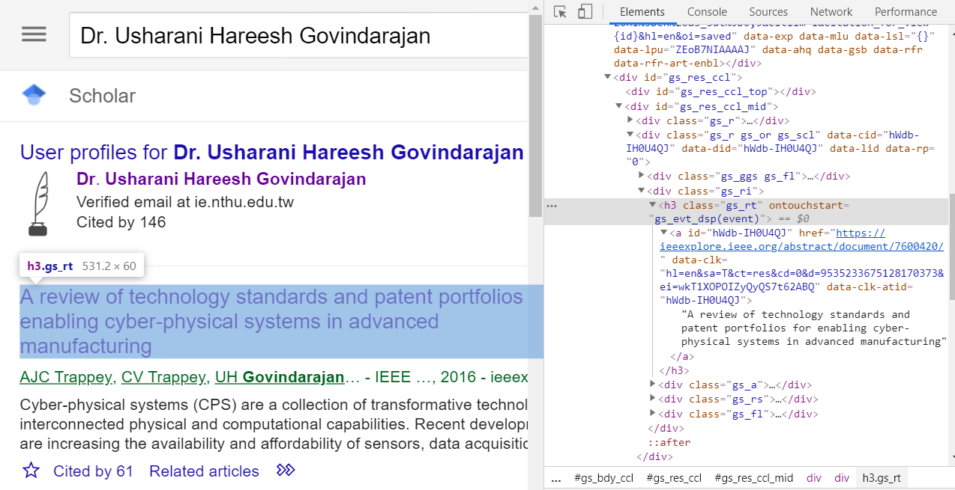

Slide 39
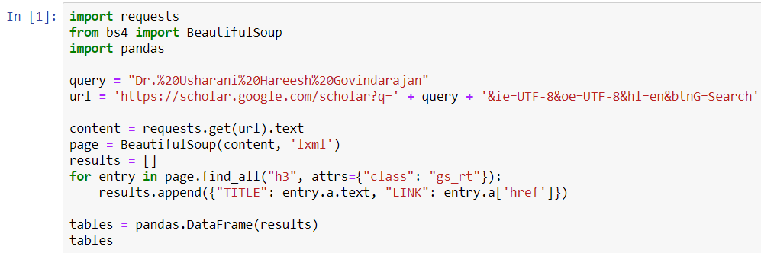

Slide 40
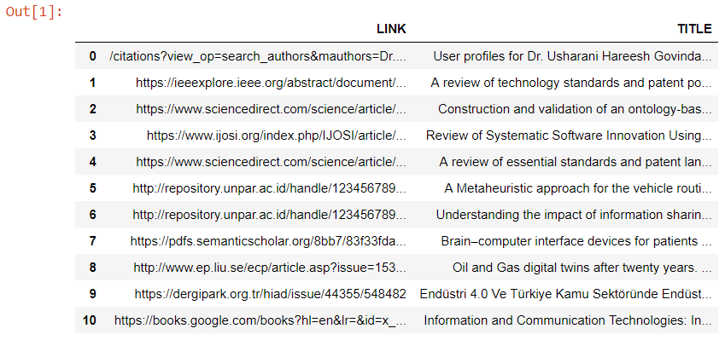

Slide 41
Further Improvements:
Making them connect to our website
Get support to obtain LinkedIn Data, or
simply buy it from data provider
Use their researches in the links to determine their area of expertise
Use their social media to determine their interest

Slide 42
Thank you!

